Slide 1

Growth and renewal for urban and rural housing
Can we make a Difference?
Ulrike Maccariello, Development Director
Hastoe Housing Association

Slide 2
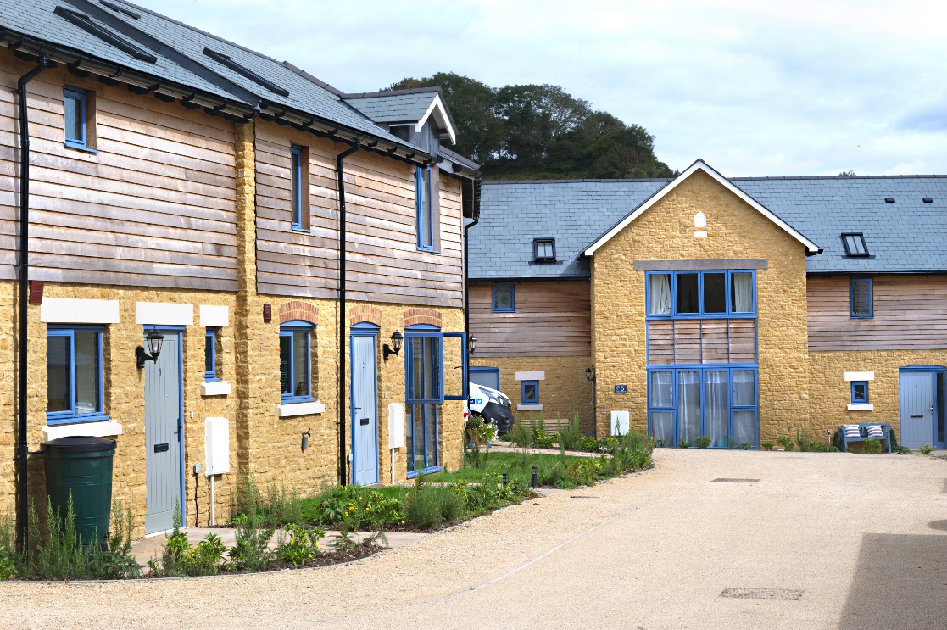
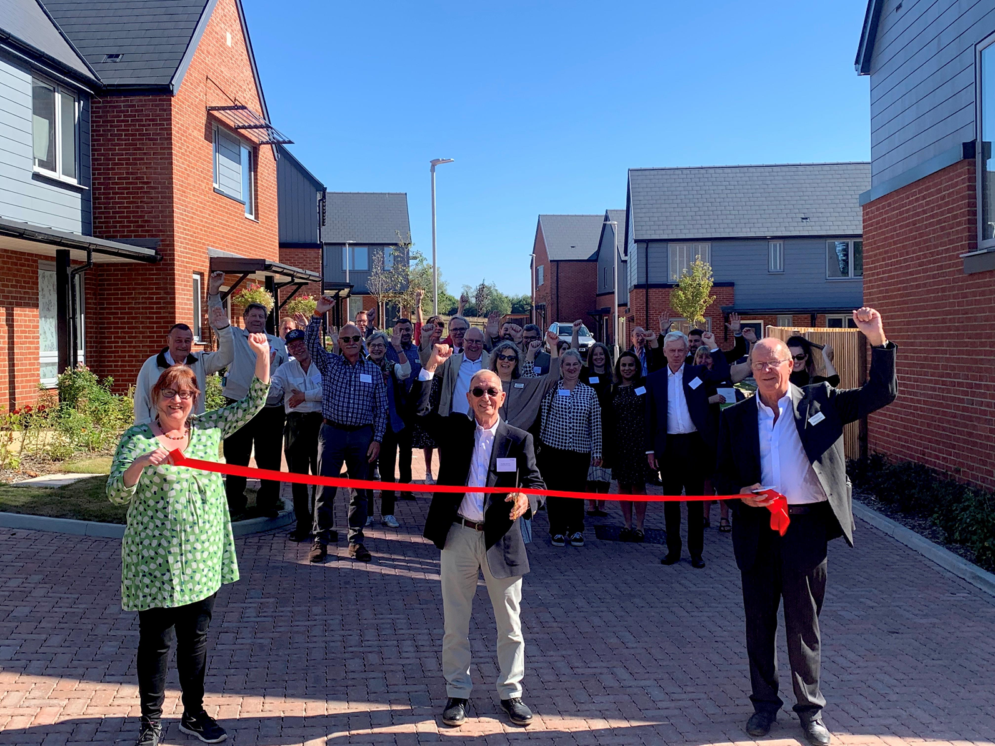
About Hastoe
Rural Housing specialist
7,500+ homes
South of England
Sustainable homes in sustainable communities
Build homes to high environmental standards

Slide 3
Rural Issues
Challenges
Chronic lack of affordable housing
Second homes / holiday lets
High housing cost – being poor where everyone else is rich
Poor infrastructure / little public transport
Lack of Services / opportunities
Fuel poverty
Lack of rural focus in levelling up agenda

Slide 4
Rural Issues
Positives
Often well integrated due to local connection criteria / local lettings plan
Access to green spaces
Family support
Make use of and support rural infrastructure

Slide 5
General Issues
Cost of living and housing
Funding models – cross subsidy / grant funding
Premium for above Building Regs specification/ energy efficiency – cost of living
Stock condition
Construction costs
Will environmental concerns override social and economic benefits?
Infrastructure Levy

Slide 6

Where we make a difference
Deliver affordable housing tailored to identified local housing need
Affordable housing in perpetuity
Principle Residence clause – Southwold
Social rent wherever possible
High energy efficiency and build standards – good for tackling fuel poverty and avoid retrofitting
Community led housing / increase in services

Slide 7
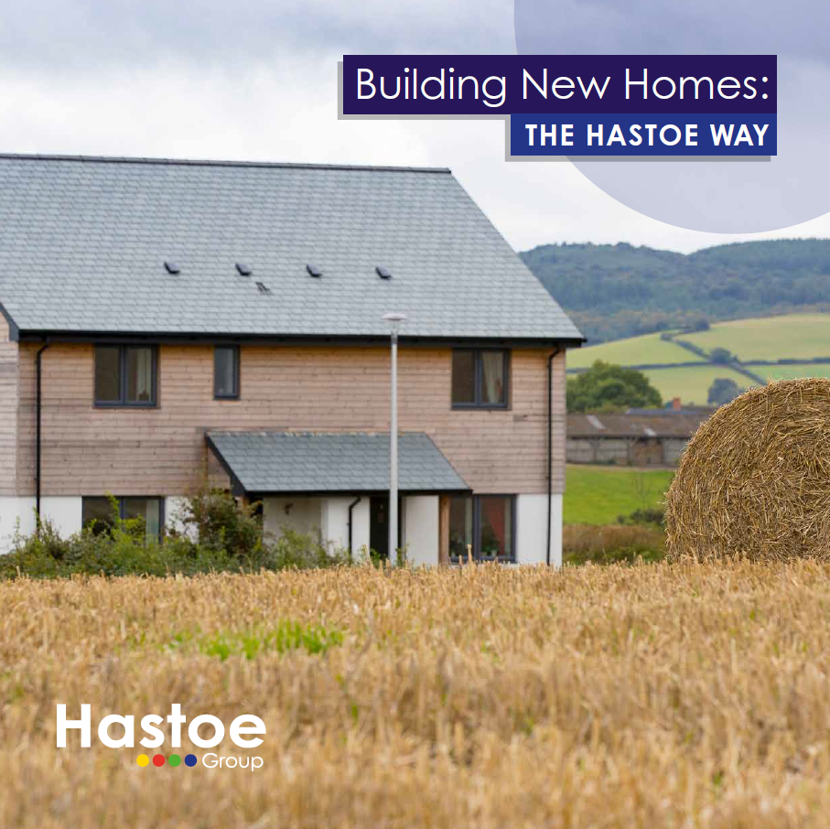
Notes:
Hastoe has a long record of being at the forefront of sustainability in housing. From requiring a minimum of level 4 of the CfSH, and delivering the first rural Passivhaus scheme in the UK at Wimbish we have always tried to address issues of carbon reduction, fuel poverty, comfort and sustainability in our developments.
Our experience of PH and AECB convinced us about fabric first , but construction industry risk premiums and unfamiliarity with those standards tended towards higher costs. Although there are pockets of really good contractors focussed on quality and innovation, we were not sure the UK construction industry as a whole was well placed to deliver them.
Whilst Building Regulations are generally heading in the right direction, we recognise that they represent the minimum acceptable standard which can be built. Recent developments have highlighted the need to improve quality across the industry and at Hastoe we wanted to incorporate all of the benefits of our ‘low energy’ experience along with a general raising of standards above that minimum.

Slide 8

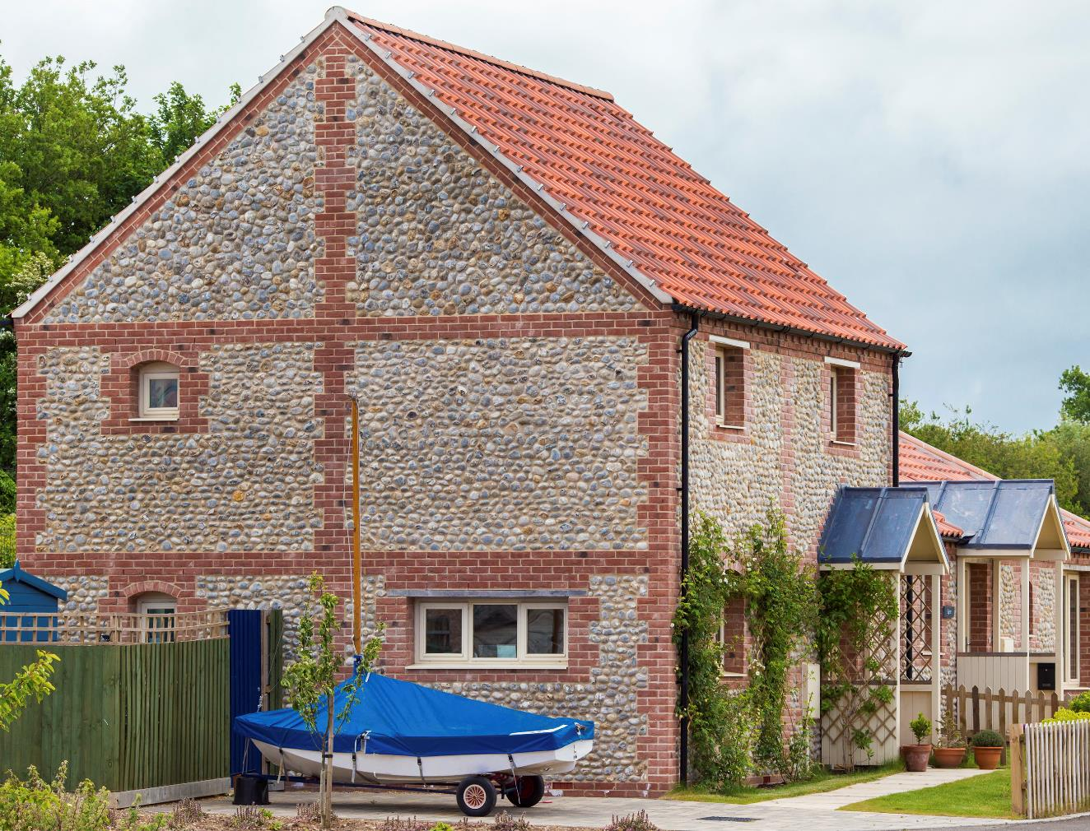
8 Key Elements
Energy Efficiency
Beautiful Design
Minimal Environmental Impact
Adaptability and Accessibility
Property Size
Quality Control
Future Proofing
Reduced Water Consumption

Slide 9
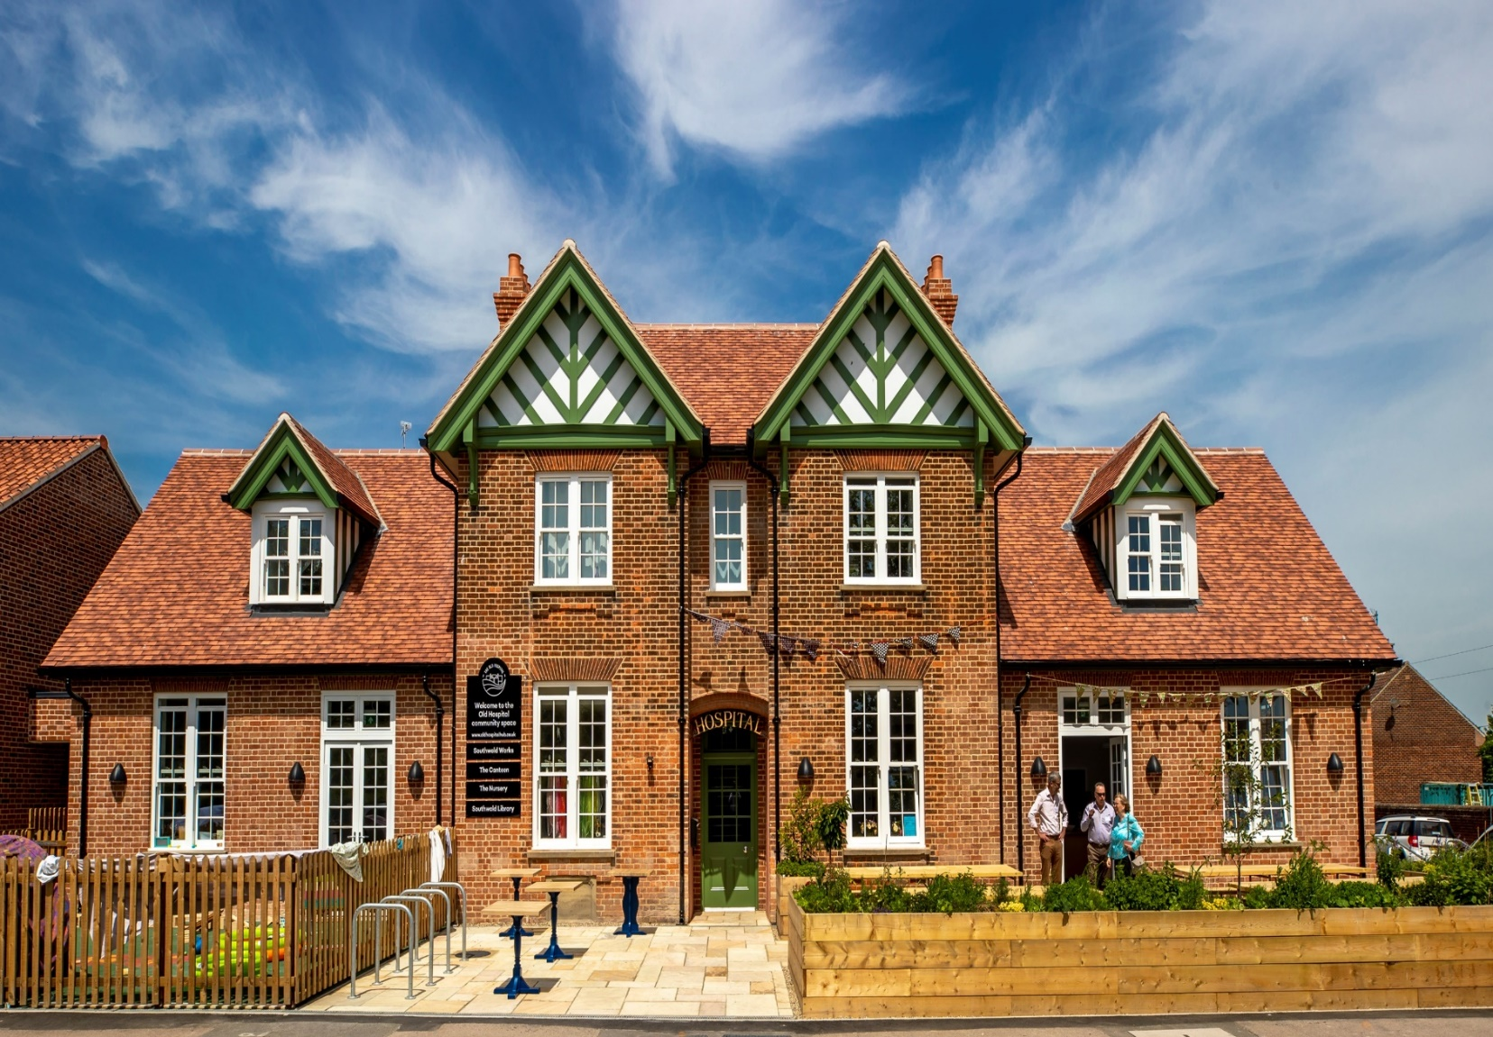

Community-led housing - Southwold
Conversion of cottage hospital into community hub and affordable housing
Partnership with SouthGen
Funding partners
Local lettings plan
www.hastoe.com/southwold-hospital

Slide 10
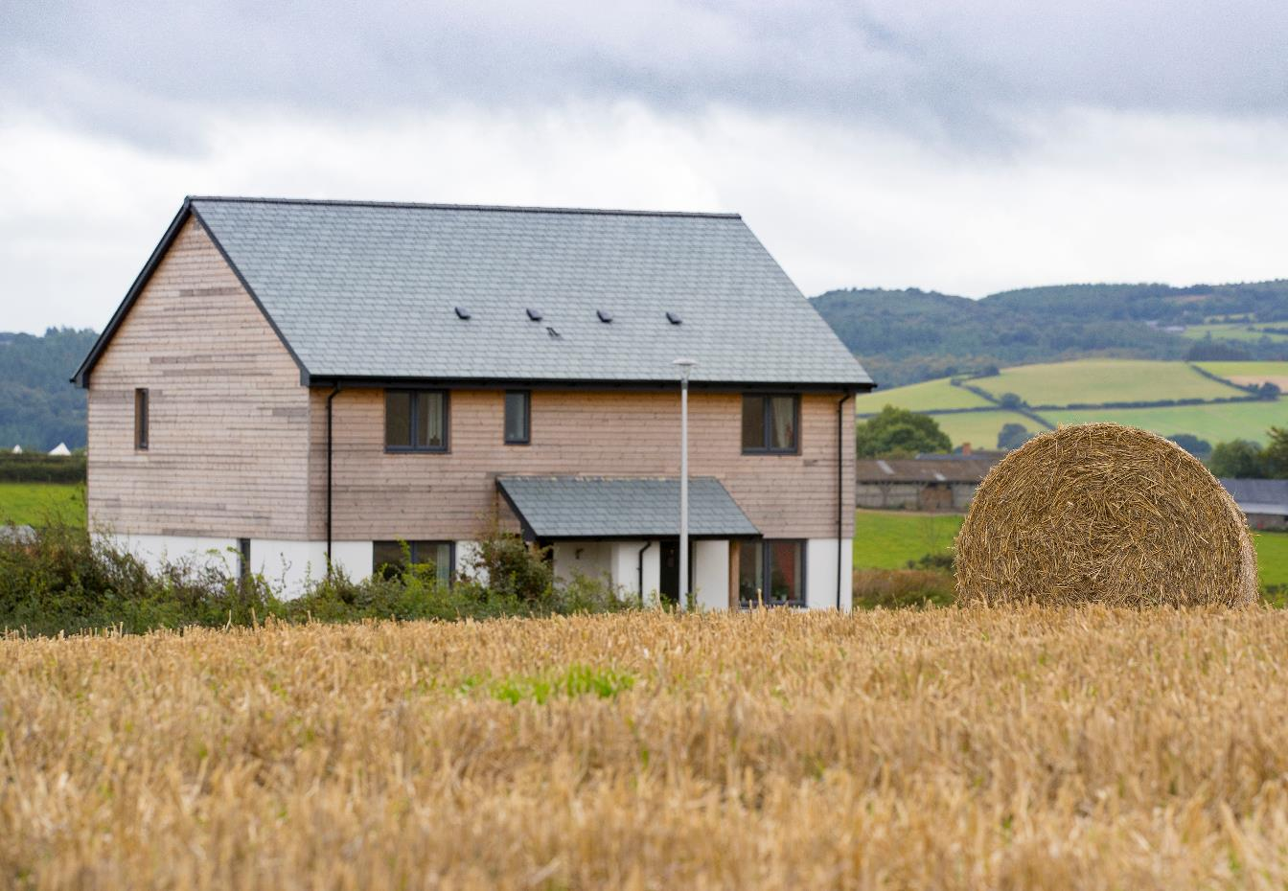
Questions & Answers
Hastoe’s New-Build Standard:
www.hastoe.com/new-build-standard
Hastoe’s ‘Designing New Homes’
www.hastoe.com/design-guidance

