Slide 1
The Woodland Carbon Code
THFC Symposium, Cambridge, 13 July 2022
Dr. Pat Snowdon, MICFor,
Head of Economics and Woodland Carbon Code
Scottish Forestry

Slide 2
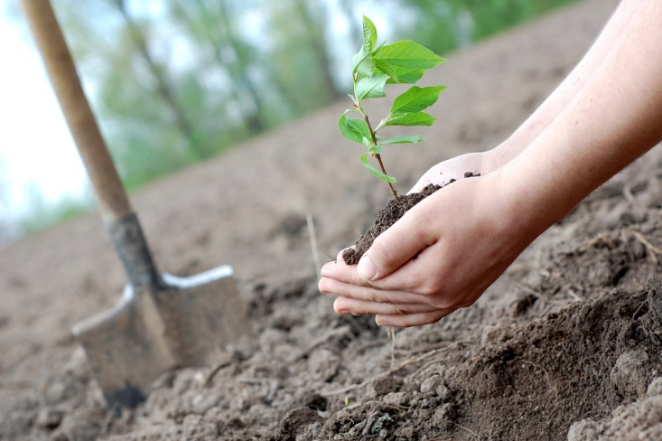





Overview
What is the Woodland Carbon Code?
UK’s govt-backed, domestic voluntary carbon market standard
helps companies to become carbon neutral/negative
helps the UK to meet national GHG targets
woodland creation only (wide range of woodland types)
WCC’s purpose is to underpin market trust and confidence
2011
launched by Forestry Commission
2019
managed by Scottish Forestry under cross-border MoU
WCC team
Executive Board
(UK ‘forestry authorities’)
Advisory Board (stakeholders)
Endorsed in the wider carbon market

Slide 3





What are the main components?
Robust science
Permanence
Forestry Act, ‘buffers’, conservative estimates
Transparency (carbon registry)
Infrastructure for monitoring, reporting and verification
Independent validation & verification
Additionality
action above ‘business as usual’

Slide 4
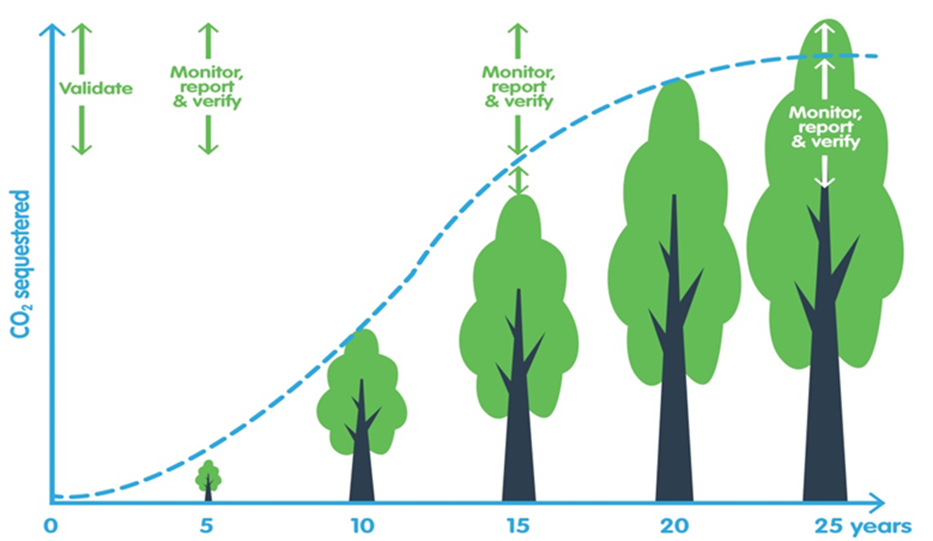
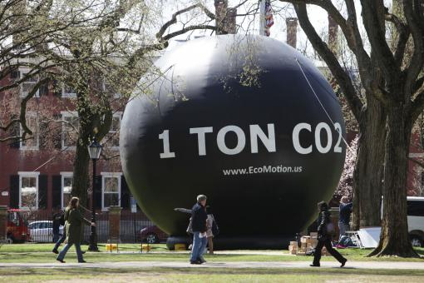
Carbon credits under the WCC
Pending Issuance Units (a promise to deliver) – validated but not verified
Woodland Carbon Units (actual sequestration) – validated and verified
One unit = one tonne CO2
Pending Issuance Units
Woodland Carbon Units
Up to 500 units per hectare (over 50 yrs or more)
Both types of units can be sold, but only WCUs can be used as offsets
Prices/tCO2 – 2011 (£5 or less), 2015-20 (£5-15), 2022 (£15-20, even £30+)
Part of a cost-effective approach to GHG mitigation

Slide 5

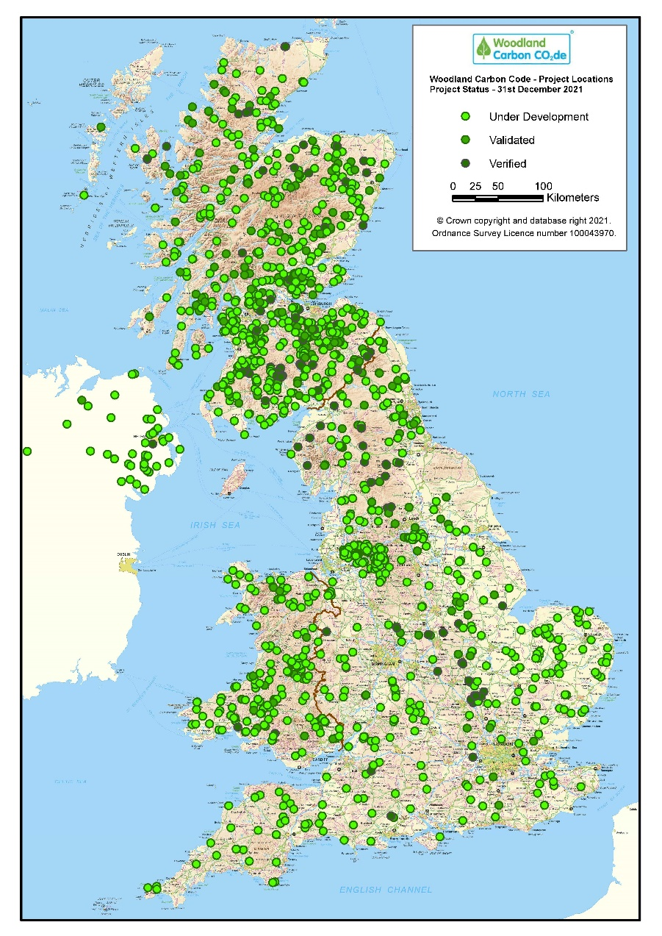
Progress - UK (as of 31/03/2022)
366 projects validated
18,544 ha woodland
6.9 MtCO₂ over lifetime
Of which
119 projects verified at yr 5
4,416 ha woodland
1.9 MtCO₂ over lifetime
In the pipeline:
1,168 projects
40,905 ha
11.9 MtCO₂ over lifetime
> 500 corporate buyers

Slide 6
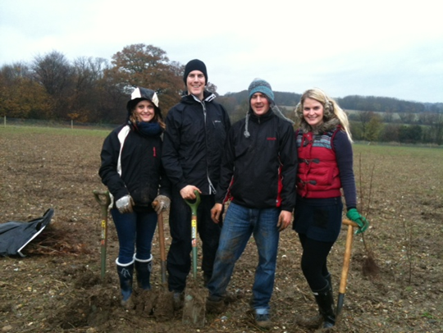
Waitrose
Since 2011 with Woodland Trust
Compensate for home delivery fleet emissions over time
Warcop, an MOD site in an AONB, Cumbria
Bought over 22,000 carbon units
Why?
Believe in trees, biodiversity, recreation & flood control benefits
Environmental and CSR credentials
Strong marketing messages to stakeholders
Staff engagement through tree planting

Slide 7
Future integrity
Further growth
New markets
Secondary market
Wider impacts
More complex financing
Demand & supply side integrity
Regulatory oversight
Delivery of ‘charismatic’ carbon
Robust additionality
tests
Overarching standards
(ISO, VCMI, IC-VCM, UK Govt/DAs)
Regulation of VCM, market infrastructure
Monitoring wider impacts

Slide 8
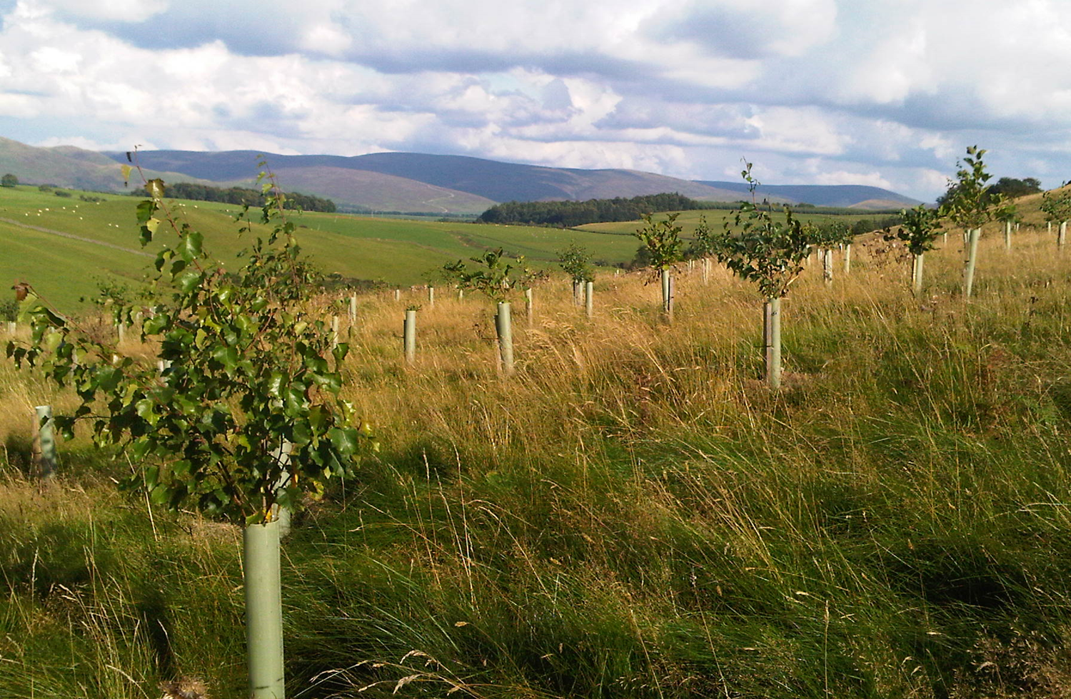
Thank you for listening
pat.snowdon@forestry.gov.scot

