Slide 1
Establishing a net zero carbon strategy
Session 12 - Plenary: Bumpy road to 2050
13 July 2022
Notes:
Standard Template [blank] 2021-v01
Cover slide 1: Text only
Choose a short, engaging title to intrigue the viewer and create instant impact (max. three lines)
All titles should be black, sentence case, using Segoe UI (with bold text style applied)
Add a descriptive supporting line below if necessary
For definition, ensure supporting line is not bold
NB – there are other slide master layouts available too. Click on Insert tab and click New Slide drop down to see full selection

Slide 2
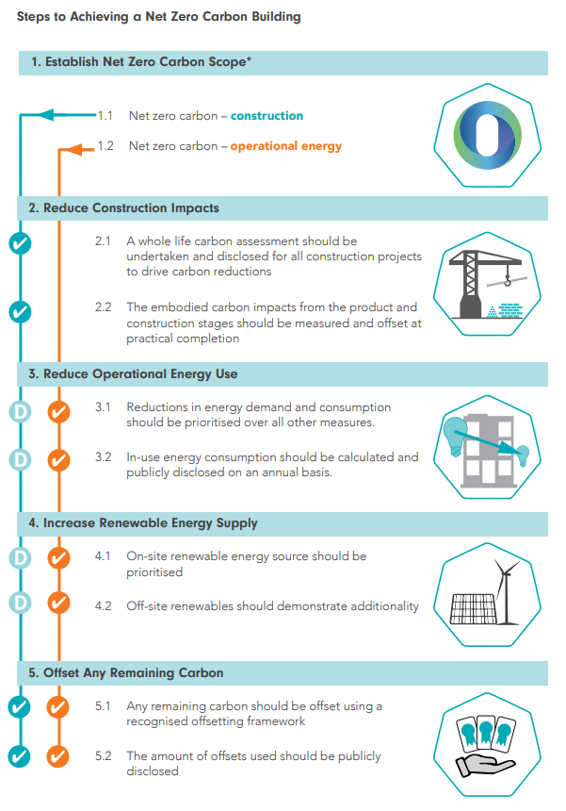




NZC definitions and frameworks
Notes:
We modelled 4 intervention scenarios versus a baseline of EPC D
Graph shows costs of getting to C, B, A and A+
£25k to EPC C with insulation improvements
£60k to EPC A and removing fossil fuels to enable net zero carbon in operation
£70k to include some on site generation through PV

Slide 3
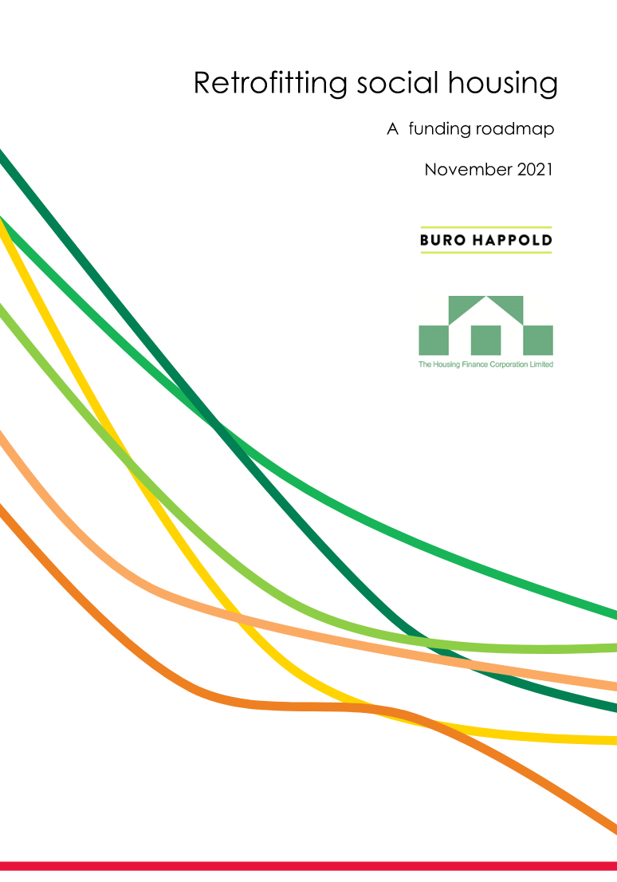

Funding the transition

Slide 4
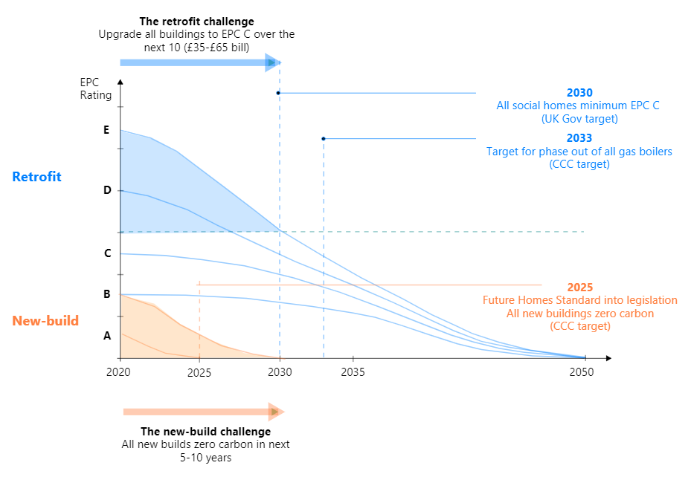
The Challenge
Notes:
Focusing on the retrofit challenge. Getting Ds and Es up to C as a minimum by 2030
With an eye to the future – net zero carbon by 2050
Most ESG strategies just focussed on EPC C by 2030 but not so much on longer term target of zero carbon

Slide 5
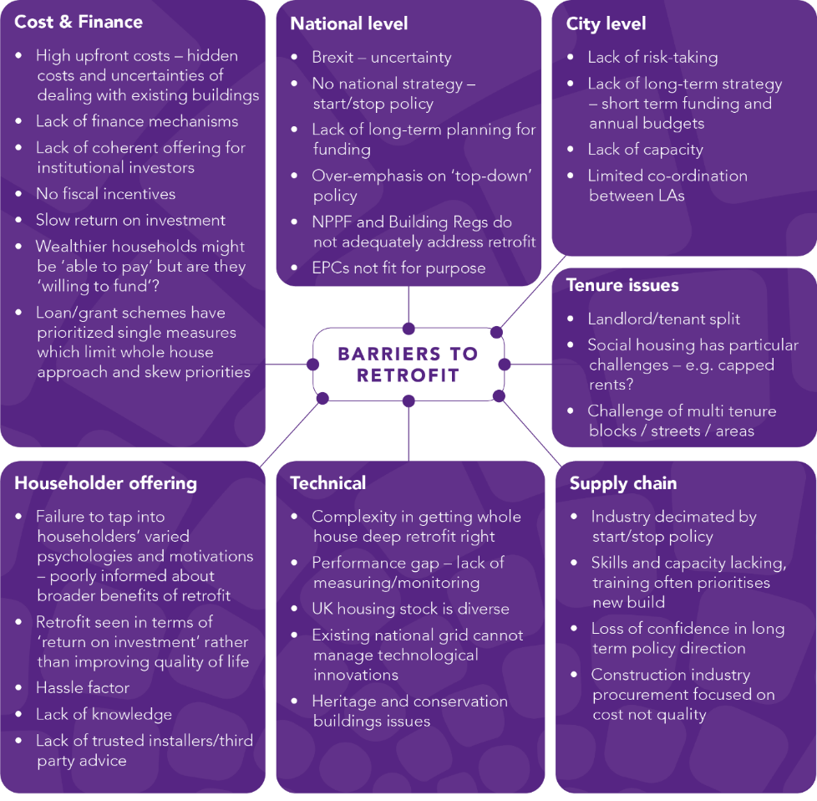
The Challenge
Notes:
Focusing on the retrofit challenge. Getting Ds and Es up to C as a minimum by 2030
With an eye to the future – net zero carbon by 2050
Most ESG strategies just focussed on EPC C by 2030 but not so much on longer term target of zero carbon

Slide 6
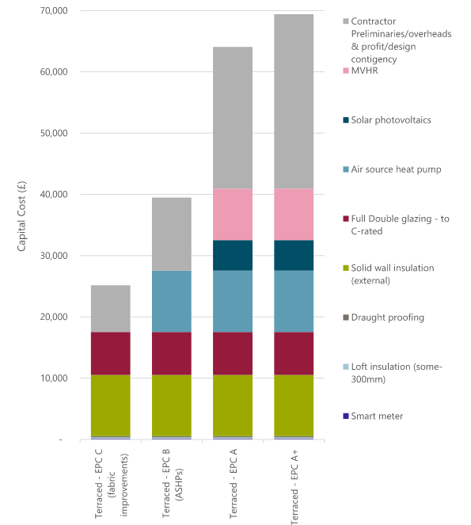
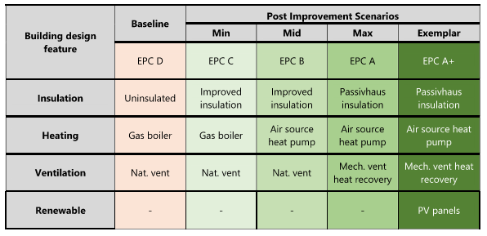
Retrofit scenarios & capital cost
4 intervention scenarios modelled vs. baseline of EPC D
£25k to upgrade to EPC C via insulation improvements
Upwards of £60k to improve fabric and remove fossil fuels
Notes:
We modelled 4 intervention scenarios versus a baseline of EPC D
Graph shows costs of getting to C, B, A and A+
£25k to EPC C with insulation improvements
£60k to EPC A and removing fossil fuels to enable net zero carbon in operation
£70k to include some on site generation through PV

Slide 7
Cost to decarbonise UK social housing
Assuming 5 million social rented houses in UK, costs could be up to £250 billion
UK Government’s Social Housing Decarb fund worth £3.8 billion over a decade
Inside Housing stated this figure as “anywhere between £12.5bn and £250bn”*
£250 billion
Assuming average £50k per household
Potential range of cost
£125 billion
Assuming average £25k per household
(Note around 60% of social housing is already EPC C and above)
*Reference: The cost of net zero: social landlords'’ decarbonisation plans, Inside Housing 23/11/2020
Notes:
Previous slide showed costs of getting from EPC D to C and above
But what’s the average cost across the whole housing stock?
Given indicative range
If every house needs £50k then costs £250billion
If every house need £25k then cost £125billion

Slide 8
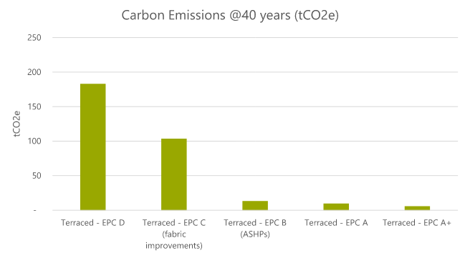
The carbon savings
Note by 2050 the UK housing stock needs to be fully decarbonised
Retention of any fossil fuels will leave us well short of targets
Heat pumps in lieu of boilers
Notes:
So far been looking at EPC as proxy for carbon emission
This slide shows tCO2 per home in 40 years time when grid is largely decarbonised
Could move faster with clean energy supply
Key takeaway is need to move beyond energy efficiency to zero carbon heating systems though heat pumps or similar

Slide 9
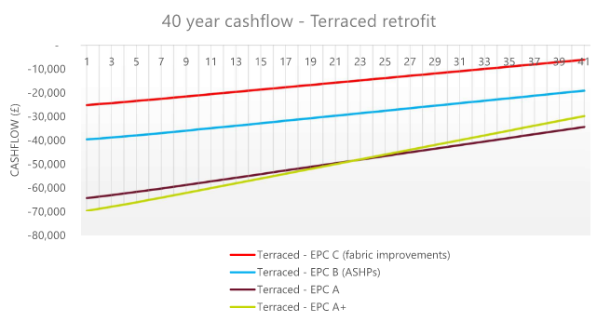
Illustrative cashflow
Focussing on retrofit of terraced house
Savings through energy bills do not payback within a realistic timescale
Notes:
Focuses on a terraced house
Cashflow of energy savings
If recent energy prices are sustained then strengthens the case for home energy retroft

Slide 10
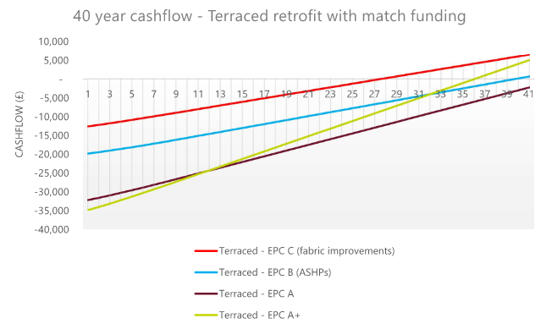
The impact of grant funding
The models here include an injection of 50% capex grant funding
Still long paybacks - the EPC C scenario pays back within 30 years with a project IRR of 2.2%
Notes:
Before market matures then need some form of capex grant funding that could taper as costs decrease
Shortens payback period to sub 30 years for EPC C

Slide 11
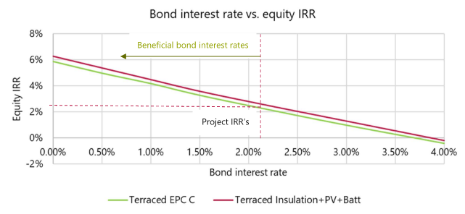
Combining grant funding with low cost debt
Attractive equity IRRs at <1% bond interest rate
The models here include an the 50% capex grant funding as well as bond to debt fund 70% of the remaining capital
Start to see viable equity IRRs of around 5% with a low interest bond (<1%)
Notes:
Combined 50% grant funding with different bond interest rates
1% interest rate gives return on equity of 4%
Start to see more attractive IRRs

Slide 12
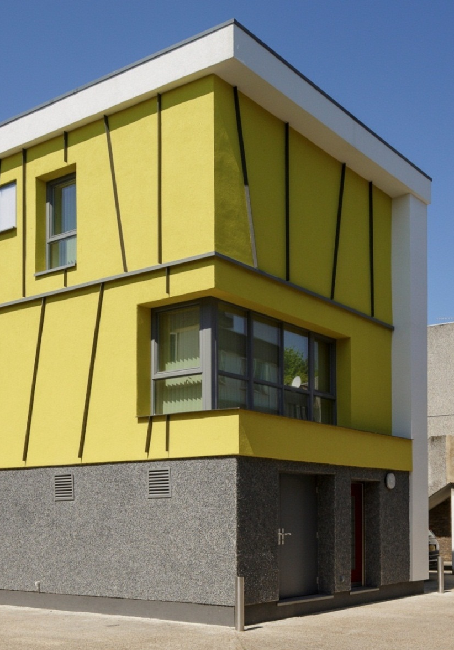
Summary
Social housing in the UK is typically more energy efficient than private housing, but the decarbonisation of heat presents a significant challenge
The finances around retrofit are extremely challenging – with a combination of grants and borrowing required to give a financially viable project
Borrowing from the capital markets for retrofit investment must be unlocked, leveraging the current strength of the green bonds market
Notes:
60% of social housing already at EPC C which is better than average across all tenures
Decarbonisation of heat present bigger challenge
Needs combination of grant and low cost debt to make projects viable
Long term, low cost capital – underwritten by government guarantee – could be the way forward.

Slide 13
THANKS!
We’d love to hear from you
Duncan Price
duncan.price@burohappold.com
Notes:
End slide
Use End slide layout as final slide for all external presentations
End presentation with a call to action or positive message encouraging further conversation
Add a contact name and email address if appropriate
Hyperlink email address (right click on selected text, choose Hyperlink, click Email Address in left panel, fill in address and click ok)
Logo and web address are already hyperlinked to www.burohappold.com
NB – there are other slide master layouts available too. Click on Insert tab and click New Slide drop down to see full selection

