Slide 1
Living standards and the transition to net zero
THFC Cambridge Symposium, 12 July 2022
James Smith, Research Director, Resolution Foundation

Slide 2
Plan
The current cost of living crisis
The long view on living standards
The role of net zero

Slide 3
The cost of living crunch

Slide 4
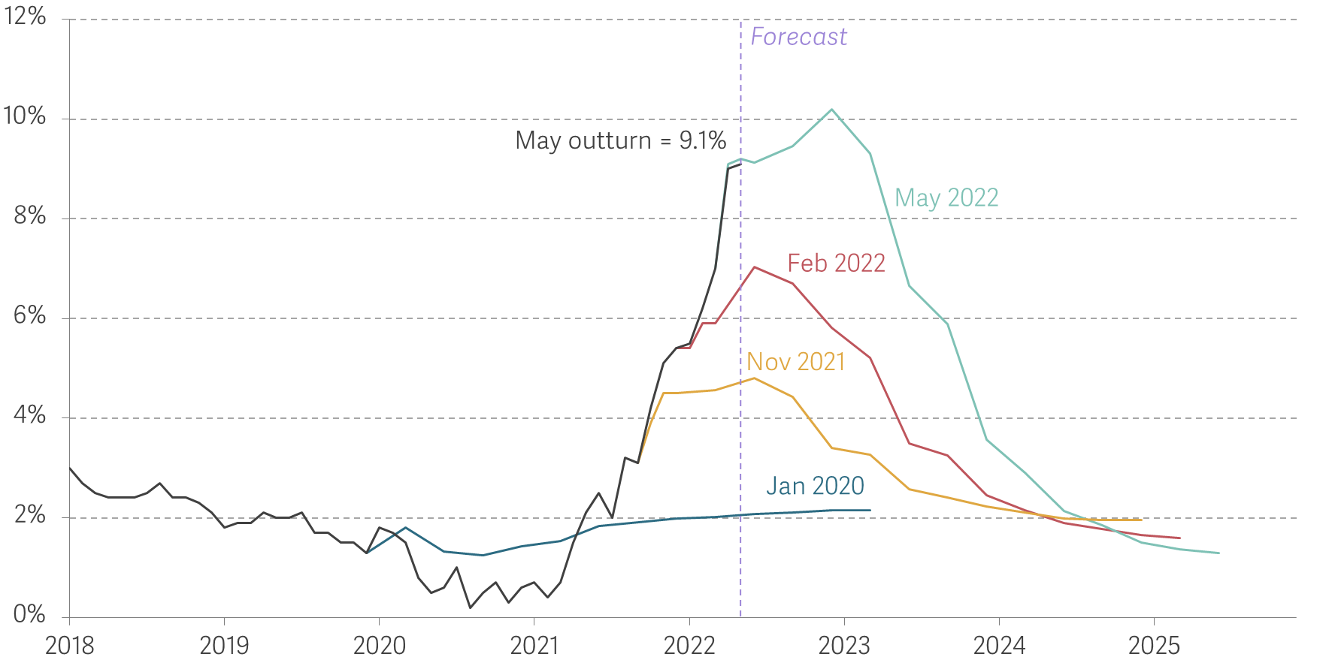
Inflation is at its highest level for 40 years and is forecast to go higher
Annual CPI inflation: outturn and various Bank of England forecasts
Source: RF analysis of ONS, Consumer Prices; Bank of England, Monetary Policy Report – May 2022.

Slide 5
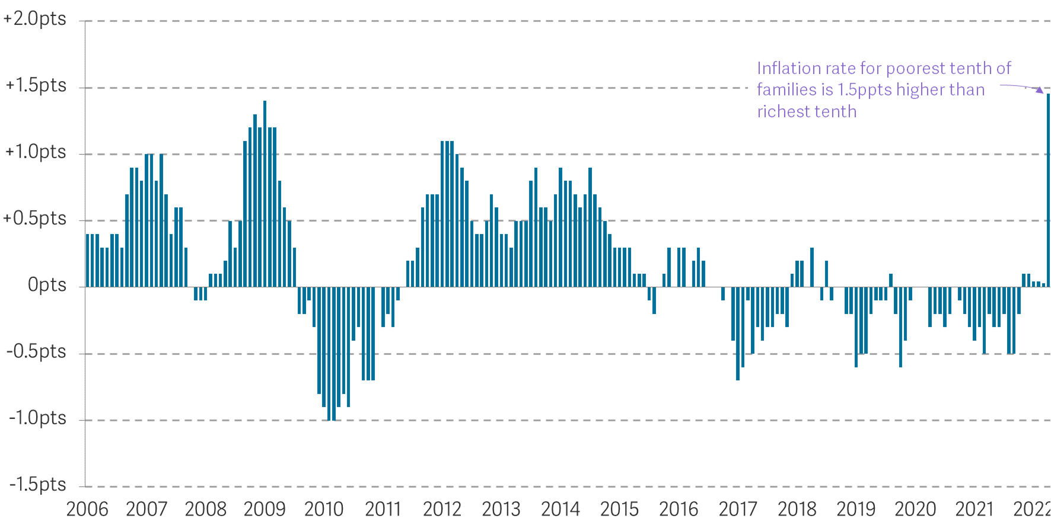
This type of inflation hits the poorest hardest
Gap between estimated CPI-consistent inflation rate for lowest equivalised disposable income decile and highest decile: UK
Notes: Data prior to 2022 are ONS-produced estimates. After 2022, these are calculations from Resolution Foundation constructed to be consistent with the overall CPI index.
Source: RF analysis of ONS, Consumer Prices & Living Costs and Food Survey.

Slide 6
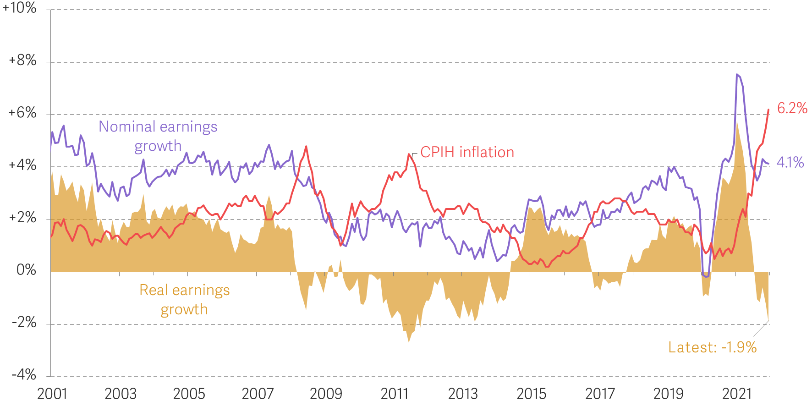
Wages are not keeping pace with inflation
Annual growth in average weekly earnings (regular pay) and CPIH inflation: UK
Source: RF analysis of ONS, Labour Market Statistics.

Slide 7
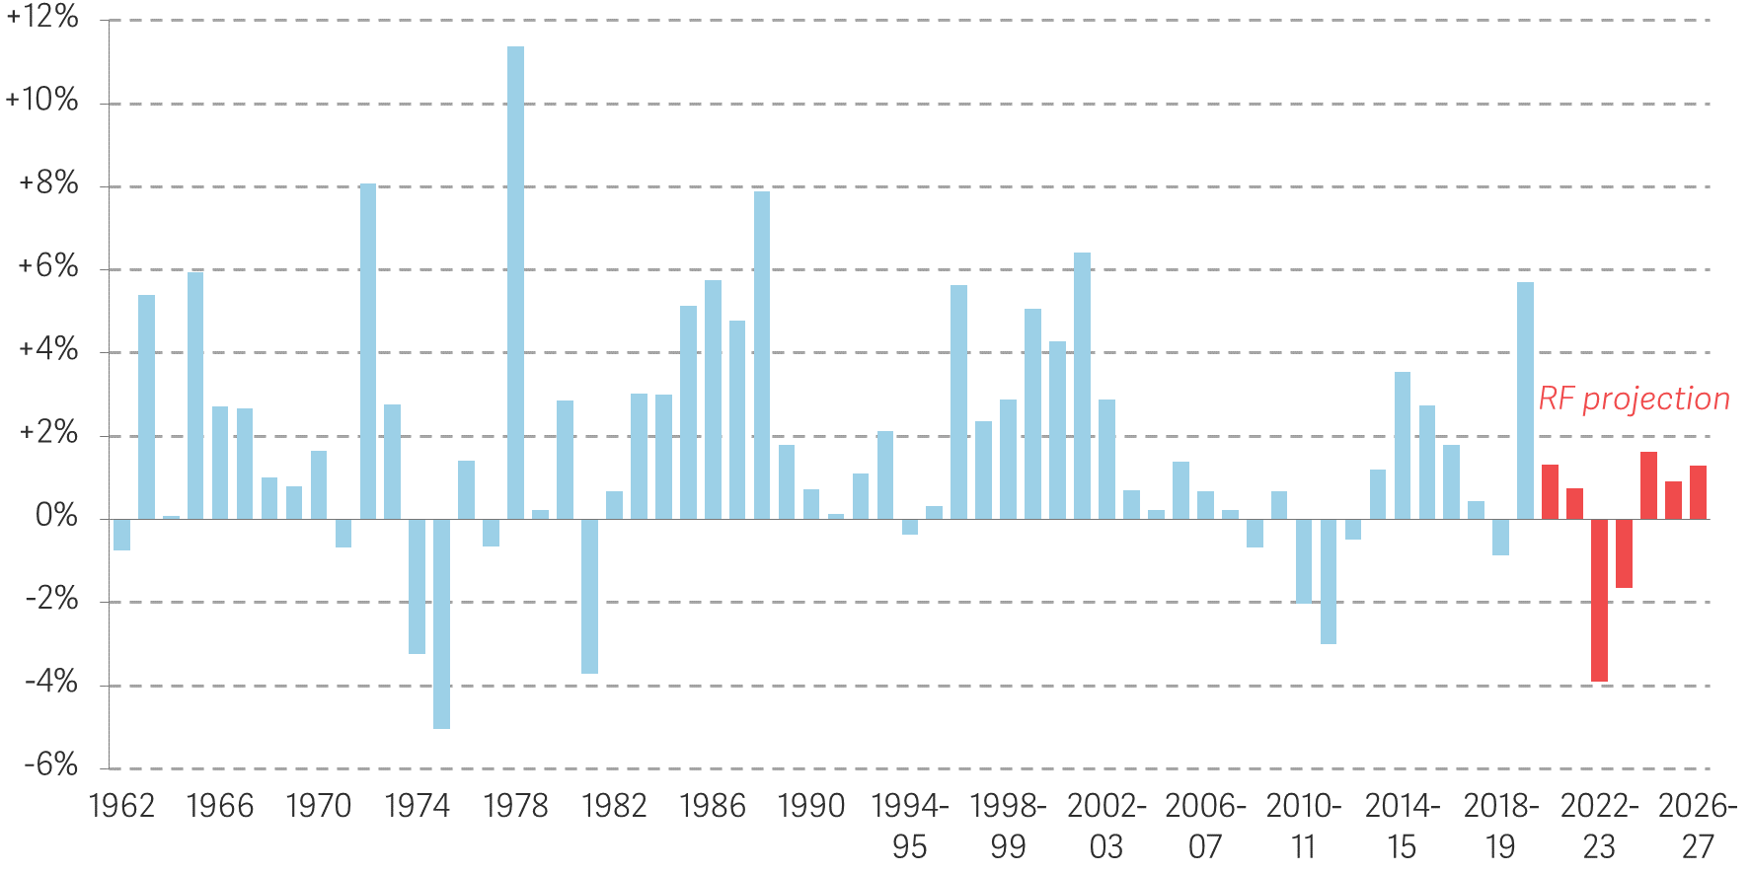
Following the Spring Statement, incomes were set to fall by over £1,000 in 2022-23
Annual real growth in median equivalised household disposable income for non-pensioners, after housing costs: GB/UK
Notes: Projections after 2019-20. Data source changes in 1994-95. GB from 1994-95 to 2001-02. See The Living Standards Outlook 2022 for details of our projection methodology.
Source: RF analysis of DWP & IFS, Households Below Average Income; and RF projection including use of the IPPR Tax Benefit Model, ONS data, and OBR forecasts.

Slide 8
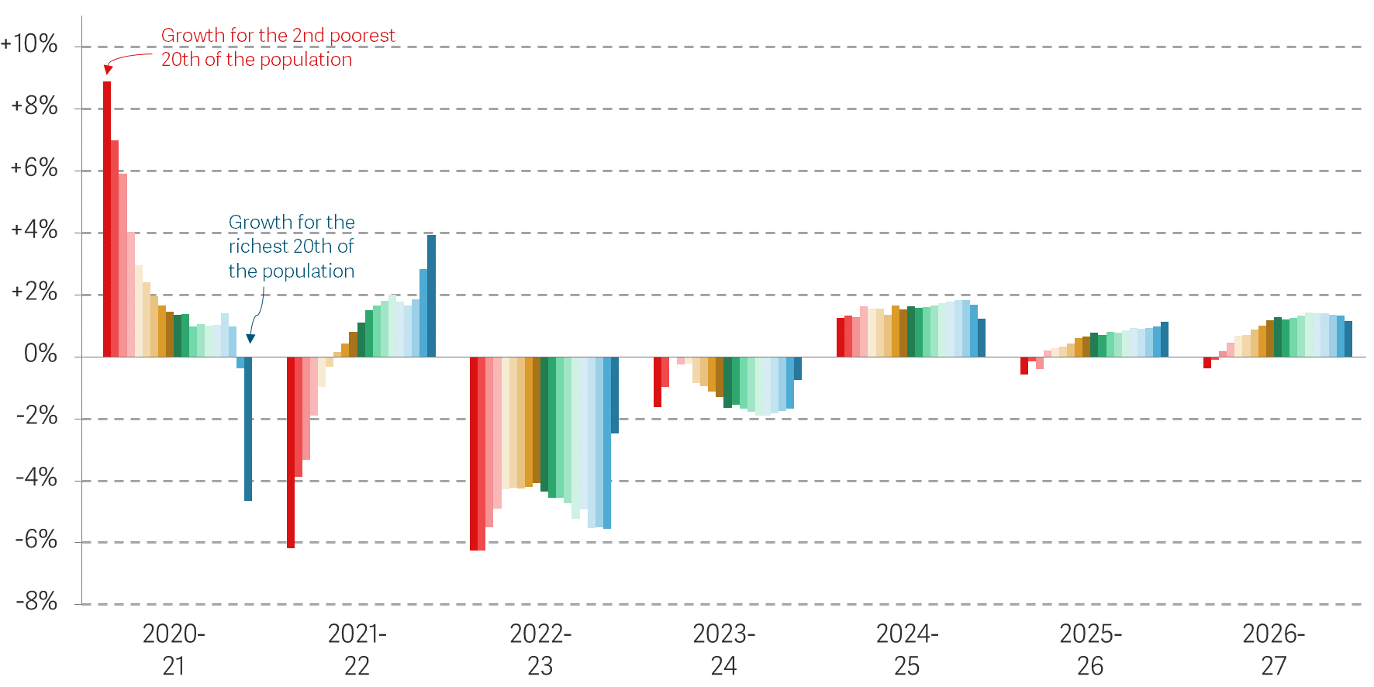
…with big declines in income this year across the distribution
Total real growth in median equivalised household disposable income per period for non-pensioners, after housing costs, by income vingtile: UK
Notes: We exclude the bottom 5 per cent, due to concerns about the reliability of data for this group. See The Living Standards Outlook 2022 for details of our projection methodology. Some periods are four years long and others five years. The chosen time periods correspond to the years of past general elections (plus 2024), but we do not include a division for the 2017 election and nor do we try to estimate growth over the February to October parliament of 1974.
Source: RF analysis of DWP & IFS, Households Below Average Income; and RF projection including use of the IPPR Tax Benefit Model, ONS data, and OBR forecasts.

Slide 9
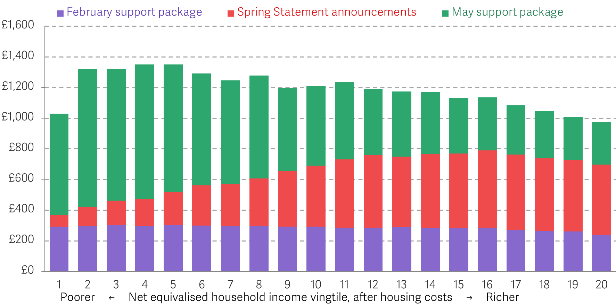
May’s cost of living support package has filled in the gaps left by earlier announcements
Annual gains from all measures announced in 2022 by equivalised after housing cost household income vingtile: 2022-23
Notes: Includes newly announced policies, 5p Fuel Duty cut and higher National Insurance thresholds, £150 Council Tax rebate and original £200 Energy Bills Support Scheme.
Source: RF analysis of DWP, HBAI; ONS, LCFS; and IPPR tax benefit model.

Slide 10
The long view on living standards

Slide 11
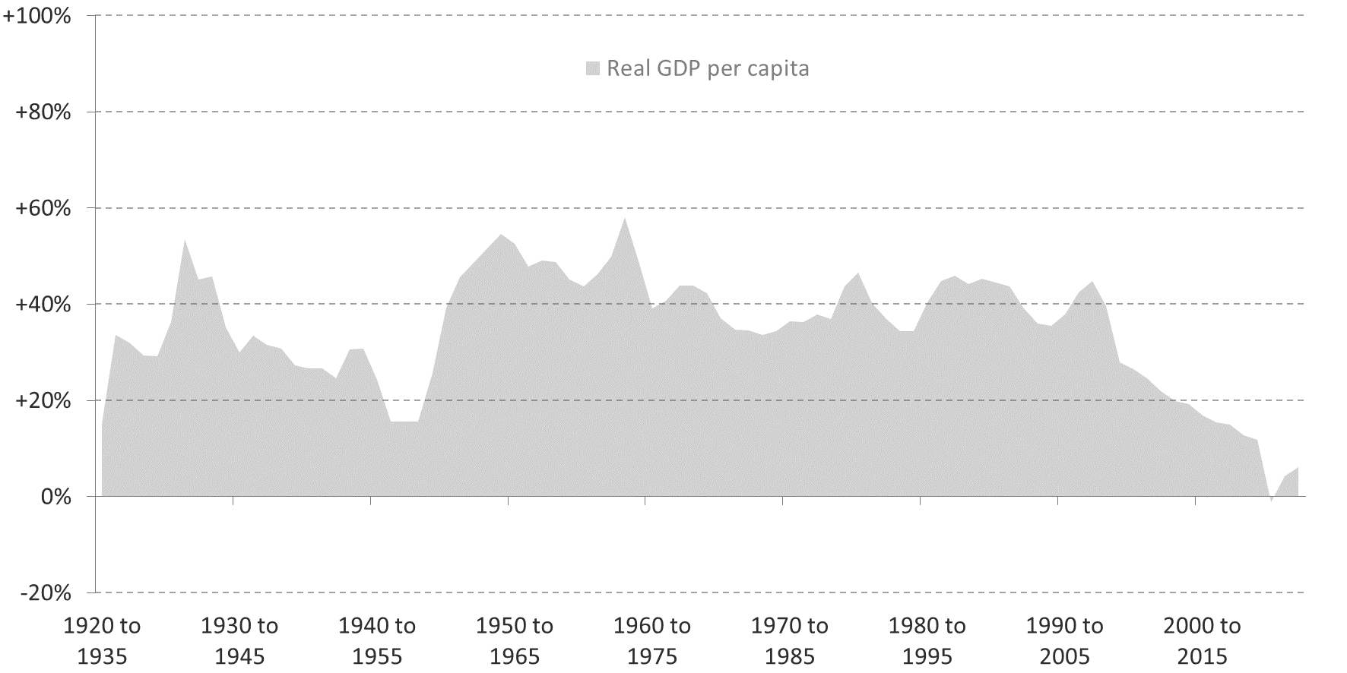
Even pre-Covid-19, medium-term growth had been weak
(for everyone)
15-year real growth rates in non-pensioner household disposable incomes, after housing costs, and GDP per person: GB/UK
Notes: Disposable income data is GB from 1994-95 to 2001-02.
Source: RF analysis of DWP & IFS, Households Below Average Income; Bank of England, A millennium of macroeconomic data; OBR, Economic and Fiscal Outlook.

Slide 12
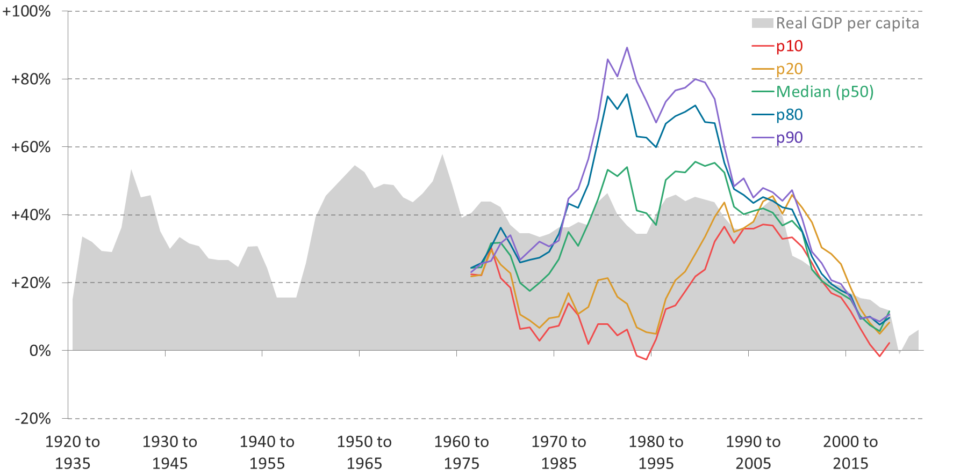
Even pre-Covid-19, medium-term growth had been weak
(for everyone)
15-year real growth rates in non-pensioner household disposable incomes, after housing costs, and GDP per person: GB/UK
Notes: Disposable income data is GB from 1994-95 to 2001-02.
Source: RF analysis of DWP & IFS, Households Below Average Income; Bank of England, A millennium of macroeconomic data; OBR, Economic and Fiscal Outlook.

Slide 13
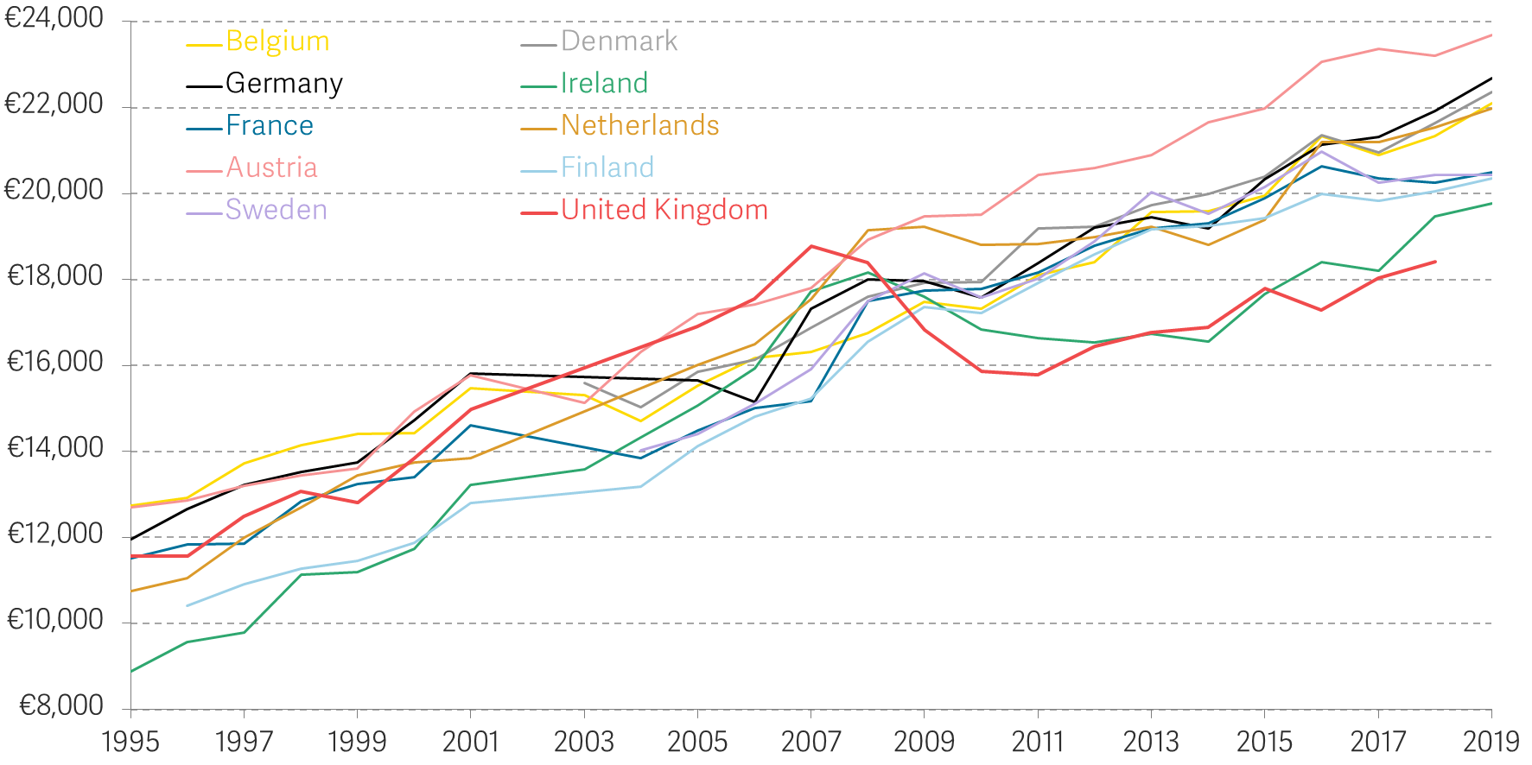
Other countries have not had such a weak period – with many overtaking the UK in typical living standards
Median equivalised disposable income, before housing costs, adjusted for purchasing power
Notes: Some gaps are interpolated, including all countries in 2002, and UK in 2003 and 2004.
Source: Eurostat dataset ilc_di04.

Slide 14
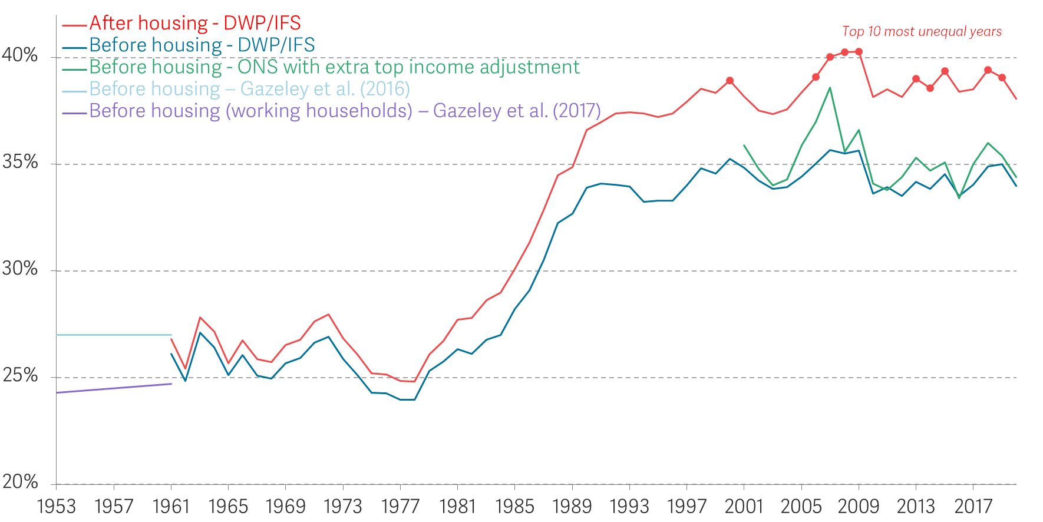
Inequality has remained high: the top 10 most unequal years were all between 2000-01 and 2019-20
Gini coefficient of income inequality: GB/UK
Notes: GB from 1961 to 2001-02.
Source: IFS, Living standards, poverty and inequality in the UK; ONS, Household income inequality, UK: financial year ending 2021; I Gazeley et al., The poor and the poorest, 50 years on: evidence from British Household Expenditure surveys of the 1950s and 1960s, 2016; I Gazeley et al., What Really Happened to British Inequality in the Early 20th Century? Evidence from National Household Expenditure Surveys 1890–1961, 2017.

Slide 15
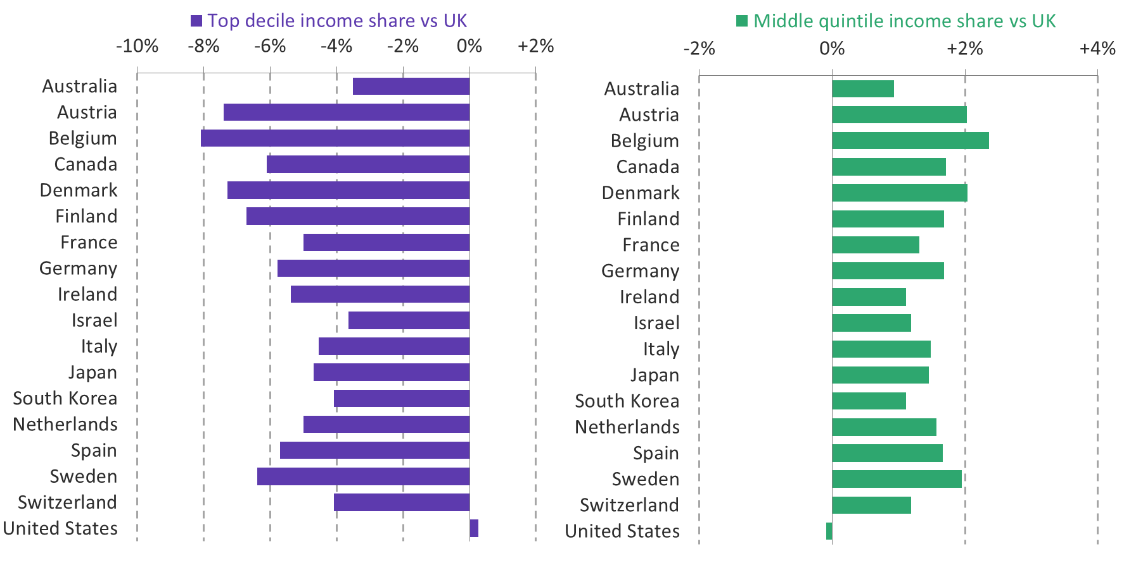
The income distribution in the UK and US is notably different from other rich nations, with higher top income shares
Percentage point differences in equivalised disposable income shares with the UK, 2019 (or latest available year)
Notes: Disposable incomes here are before housing costs.
Source: RF analysis of OECD, Income Distribution Database.

Slide 16
The income distribution in the UK and US is notably different from other rich nations, with higher top income shares
Percentage point differences in equivalised disposable income shares with the UK, 2019 (or latest available year)
Notes: Disposable incomes here are before housing costs.
Source: RF analysis of OECD, Income Distribution Database.

Slide 17
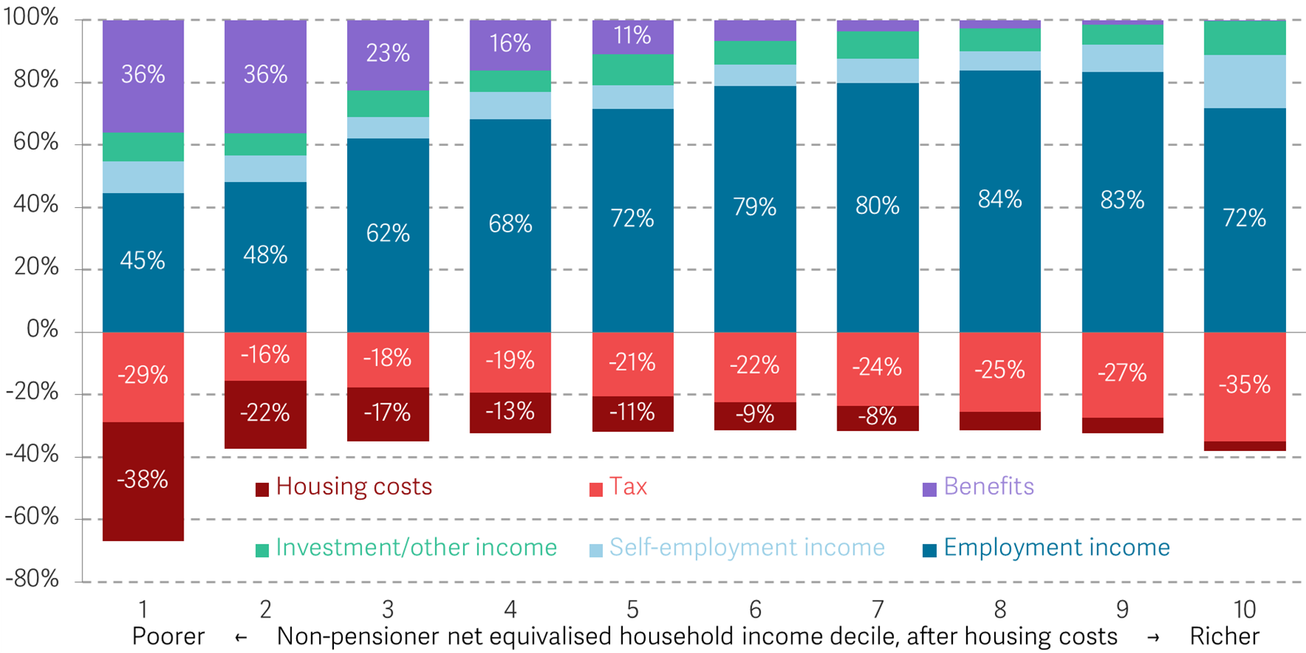
Non-pensioner income growth will depend largely on earnings (inc. employment), benefits, taxes and housing
Sources of non-pensioner household incomes as a fraction of gross household income, by income decile: UK, 2019-20
Notes: Tax refers to Income Tax, personal National Insurance and Council Tax (or Domestic Rates).
Source: RF analysis of DWP, Households Below Average Income.

Slide 18
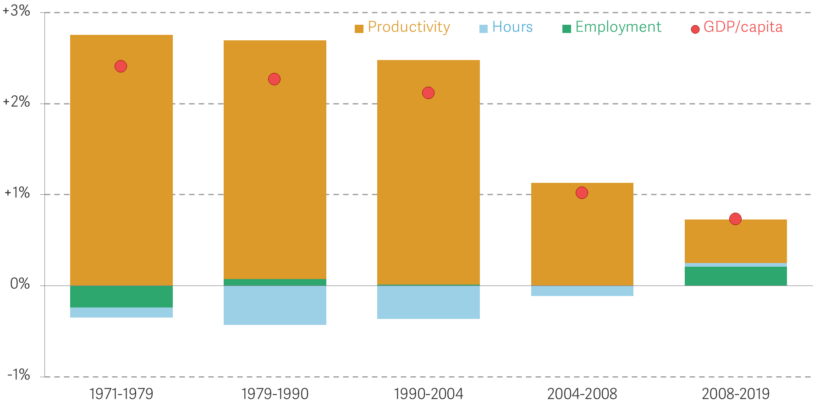
Overall income growth is driven by increases in productivity per hour
Break down of annualised growth in GDP per capita: UK
Notes: Contribution of productivity, hours and employment scaled so that sum matches GDP/capita.
Source: Analysis of Bank of England, Millennium of Macroeconomic Data; OBR, Economic and Fiscal Outlook, March 2022; ONS, Labour Productivity; ONS, Labour Market Statistics.

Slide 19
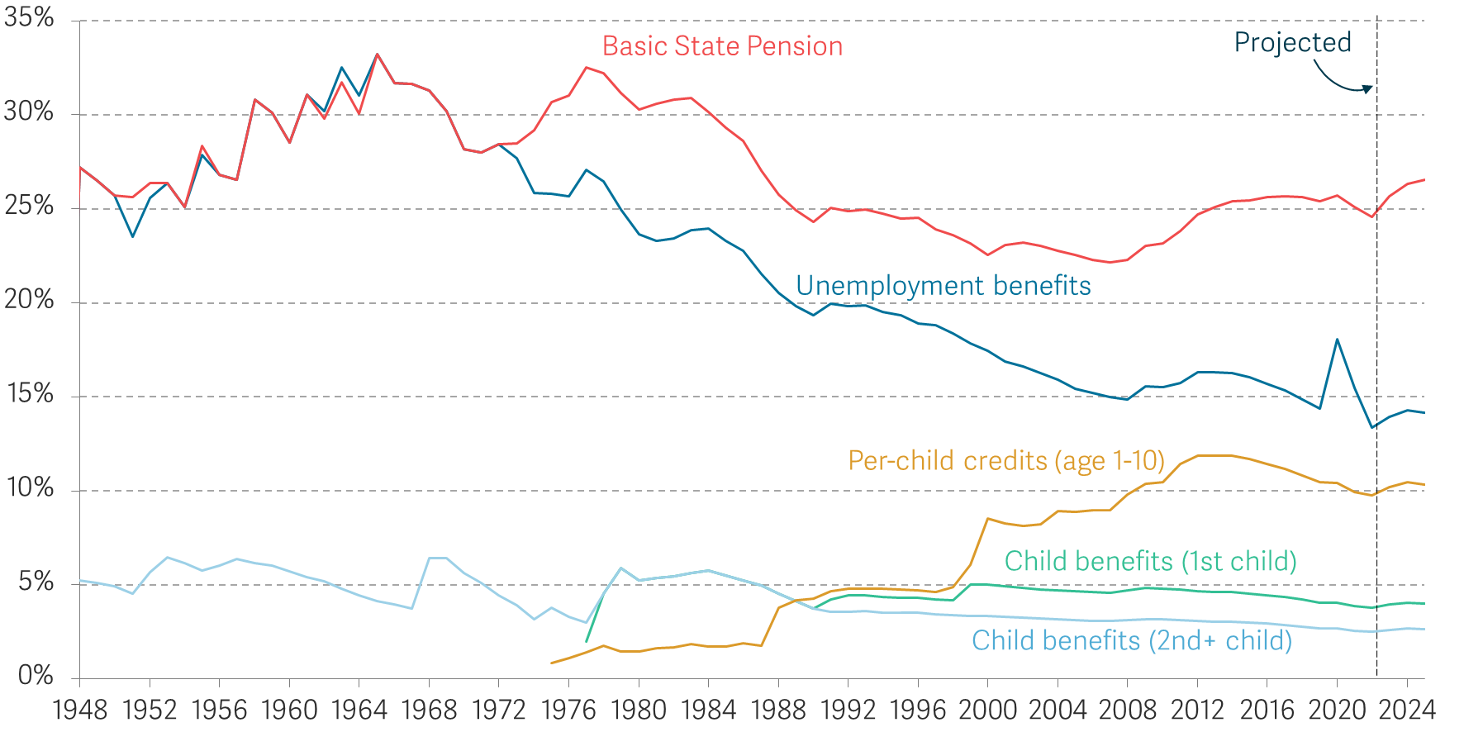
But it’s hard to deliver progressive growth without benefits rising as earnings do
Value of selected benefits as a share of average weekly earnings: UK
Source: RF analysis of ONS, Average Weekly Earnings; DWP, Abstract of Benefit Statistics; ONS, CPI; OBR, Economic and Fiscal Outlook, March 2022; Bank of England, Monetary Policy Report, May 2022.

Slide 20
The long view on living standards – the Economy 2030 Inquiry agenda
We’ve had weak growth and persistently high inequality – leaving lower-income households particularly exposed to crises
Historical and international experience suggests we can do better
Progressive growth should be a shared goal (and indeed the UK is committed to lower poverty and faster growth for the bottom 40%)
The Economy 2030 Inquiry will look at the policies needed for future shared prosperity:
  sustained productivity growth
  a labour market that delivers for workers
  a tax and benefit system that provides insurance and shares growth
  a housing market that doesn’t absorb all the proceeds of growth

Slide 21
The role of net zero

Slide 22
Where do we stand on net zero?
The UK has an impressive record on setting climate targets
Action to meet these targets is key, with the 2020s a pivotal decade
Decarbonisation will look different in years and decades to come

Slide 23
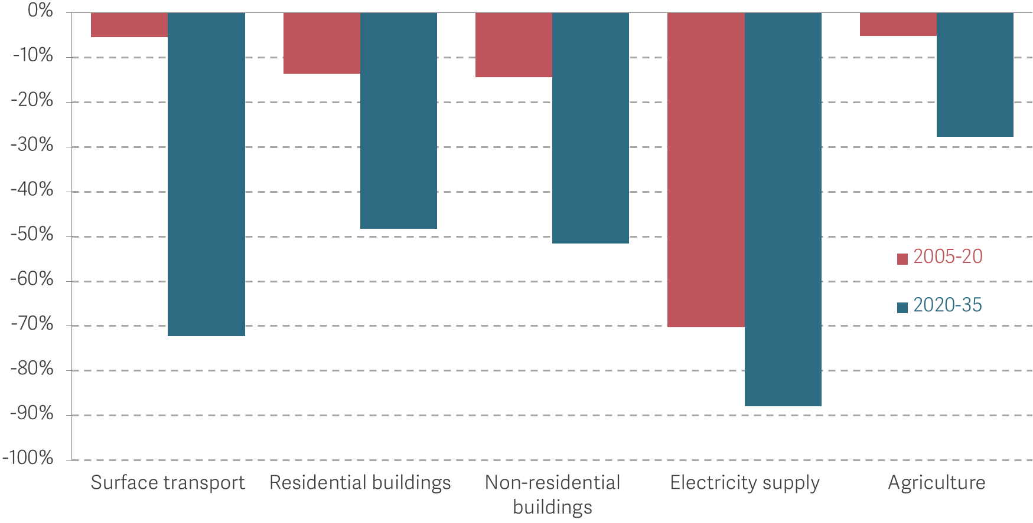
The next 15 years of decarbonisation will not be like the last
Per cent reduction in sectoral emissions from 2005-20 and those forecast from 2020-35 in the CCC’s ‘Balanced Pathway’ to net zero
Source: Analysis of CCC Sixth Carbon Budget

Slide 24
Our approach
Debate on net zero transition dominated by campaigners and opponents
Need to recognise challenges in order to overcome them
Focus on households missing from current debate
Fair distribution key in delivering net zero

Slide 25
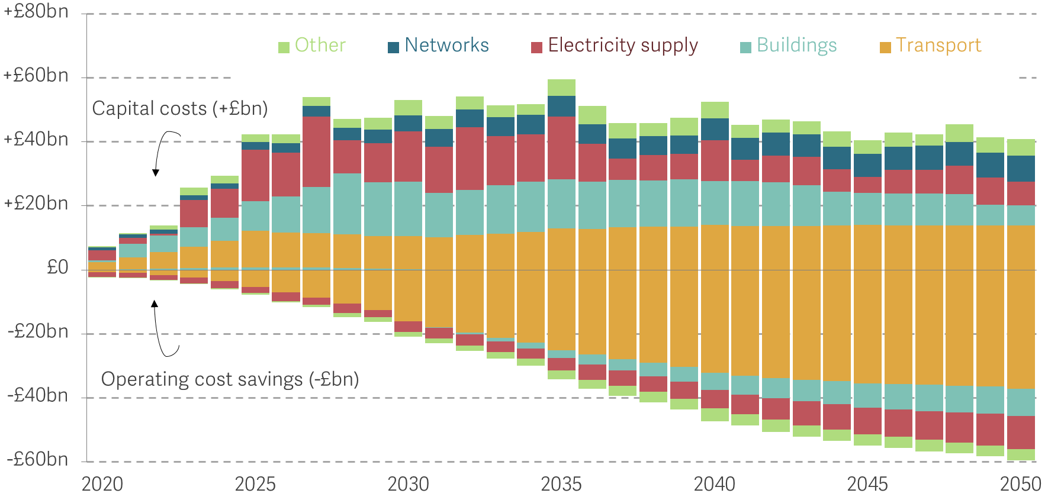
Economy wide cost forecasts hide crucial timing and distributional impacts
Capital investment costs and operating cost savings in the CCC’s ‘Balanced Pathway’ to net zero
Source: Analysis of CCC Sixth Carbon Budget

Slide 26
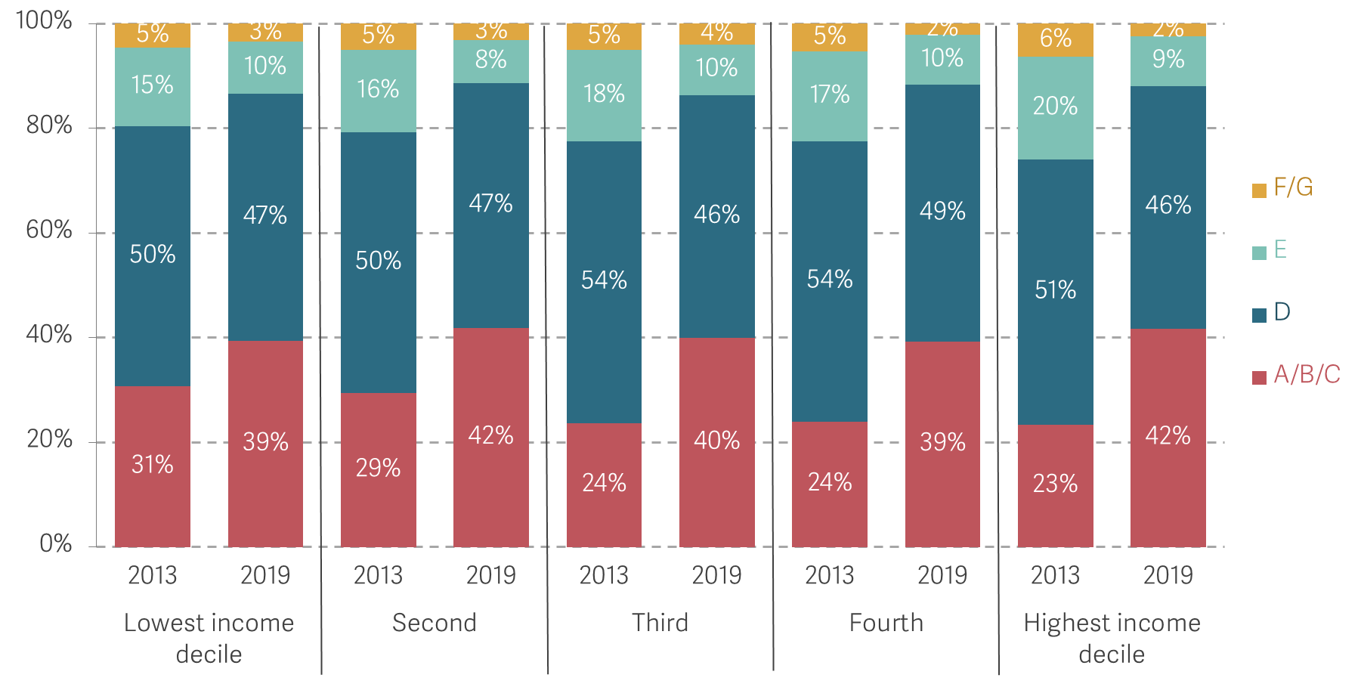
Fair distribution of costs and support is vital (but not easy)
Proportion of English homes at different Energy Performance Certificate (EPC) ratings by household income quintile: 2013-14 & 2019-20
Source: Analysis of English Housing Survey data

Slide 27
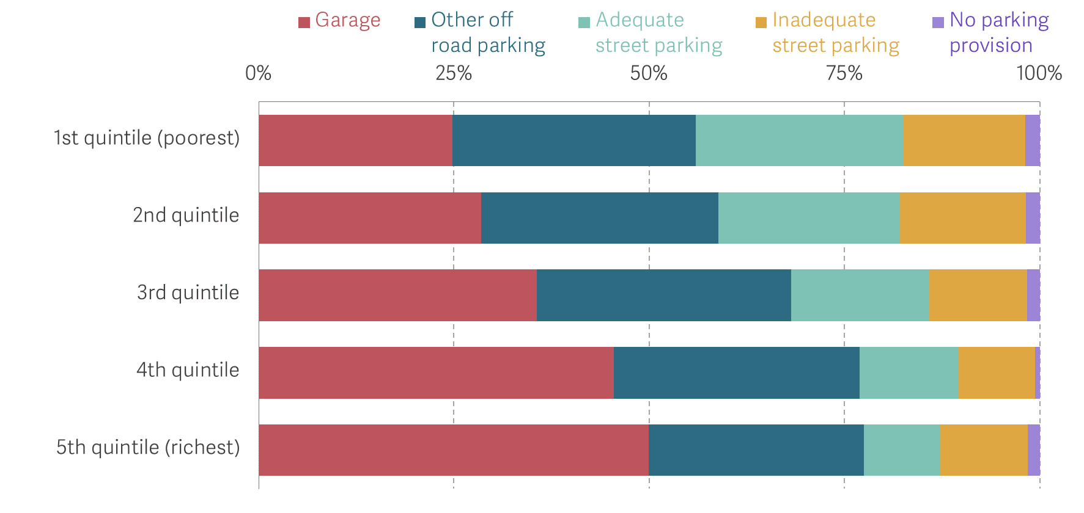
Sharing the benefits of net zero is as important as sharing the costs
Parking provision by household income quintiles: England, 2019
Notes: Categories are regardless of car ownership
Source: Department of Levelling up, housing and Communities, English Housing Survey Live Tables

Slide 28
The UK’s economic strategy needs updating in light of net zero
The 2020s will see the UK enter a new, more visible, phase of decarbonisation
Delivering this requires honesty about the challenges involved
The timing and distributional impacts of costs and benefits is key
Net zero must be placed at the centre of the UK’s economic strategy

Slide 29
Key takeaways:
Inflation is at its highest for 40 years with low income households are being hit hardest
Prioritising growth but also sharing the gains from growth is key to boosting incomes across the distribution
New phase of net zero transition necessitates focus on low income households

Slide 30
Living standards and the transition to net zero
THFC Cambridge Symposium, 12 July 2022
James Smith, Research Director, Resolution Foundation

